Slide 1
चरैवेति, चरैवेति
Keep progressing to attain a higher self.
avinash.bhagat@lpu.co.in Avinash Bhagat 9463281930

Slide 2
CAP275: Data Communication and Networking
Lecture # 4
Categories of computer Networks
LAN, MAN & WAN
avinash.bhagat@lpu.co.in Avinash Bhagat 9463281930

Slide 3
Network Technologies
Transmission Technology
Scale.
Transmission Technology:
  Broadcast networks
  Point-to-point networks
Notes:
There is no generally accepted taxonomy into which all computer networks fit, but two dimensions stand out as important:

Slide 4
Based on Scale
They are divided into:
Local Area (LAN)
Metropolitan Area Network (MAN)
Wide Area Networks (WAN).
The other types can be
  Personal Area N/W PAN
  Body Area N/W BAN
  Home Area N/W HAN
  Storage Area N/W SAN
  Campus Area N/W CAN

Slide 5
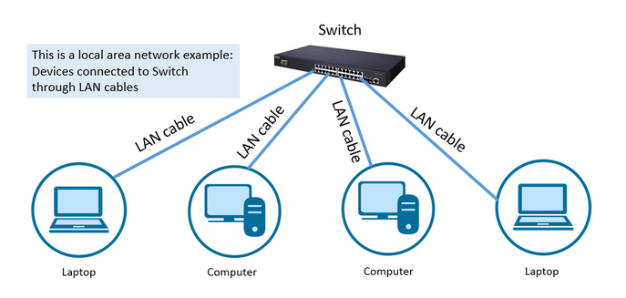
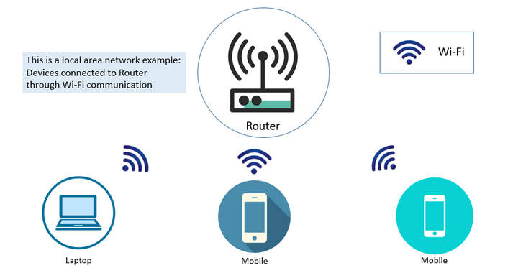
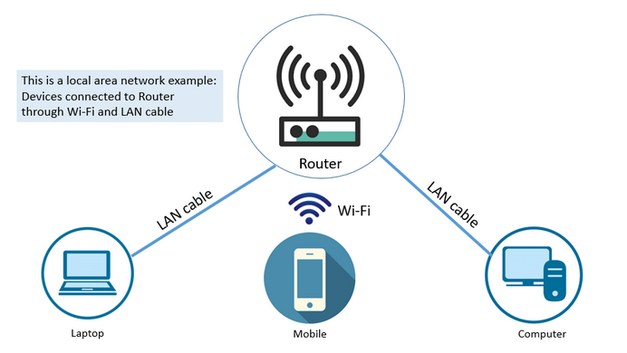
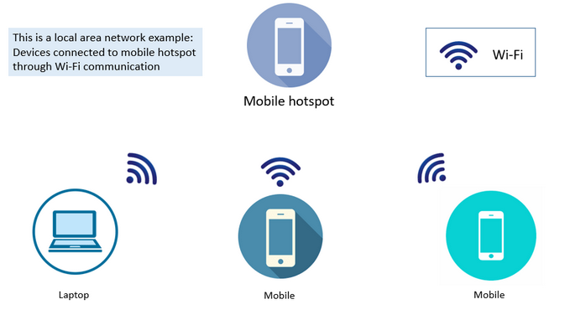
Local Area Network
Notes:
A local area network (LAN) is usually privately owned and links the devices in a single office, building, or campus. LAN size is limited to a few kilometres.
Example
a LAN can be as simple as two PCs and a printer in someone's home office;
It can extend throughout a company and include audio and video peripherals.

Slide 6
Local Area Network
Local Area Network
LANs are designed to allow resources to be shared between personal computers or workstations.
The resources to be shared can include
  hardware (e.g., a printer),
  software (e.g., an application program),
  data.

Slide 7
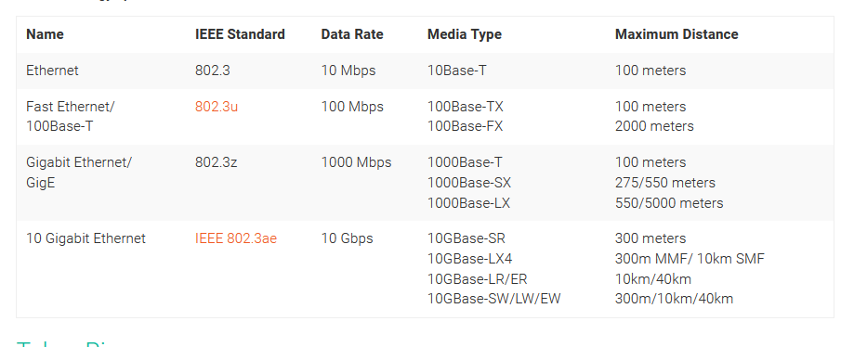
Local Area Network
Local Area Network

Slide 8
Local Area Network
Traditional LANs run at speeds of 100 to 1000 Mbps (but now much higher speeds can be achieved).
High speed LANs are boosting the speed up to 10 Gbps
The most common LAN topologies are:
Bus
Ring
Star

Slide 9
Metropolitan Area Network
MAN is designed to extend over the entire city.
MANs typically cover transmission ranges between 5 and 10 km in diameter and may cover an area the size of a city, or even a group of small buildings.
MANs often act as a high-speed network that allows sharing of regional resources and also provide a shared connection to other networks.
Notes:
MANs are larger than LANs and generally are not owned by a single organization; instead their communications links and equipment are generally owned by either a consortium of users or by a single network provider who sells the service to the users.
MANs can also mean the interconnection of several LANs by bridging them with backbone lines.

Slide 10
Metropolitan Area Network
Wireless metropolitan area networks (WMANs) are used to establish wireless connections between multiple locations within a metropolitan area, such as between multiple office buildings in a city or on a university campus, without the high cost of laying fiber or leasing lines. For optical wires communications, infrared light can be used to transmit data.
MANs is defined IEEE 802.6.
Notes:
MANs are larger than LANs and generally are not owned by a single organization; instead their communications links and equipment are generally owned by either a consortium of users or by a single network provider who sells the service to the users.
MANs can also mean the interconnection of several LANs by bridging them with backbone lines.

Slide 11
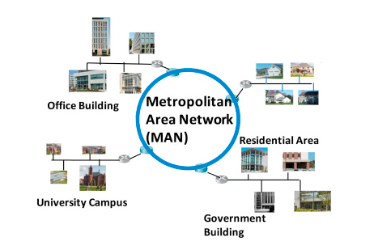
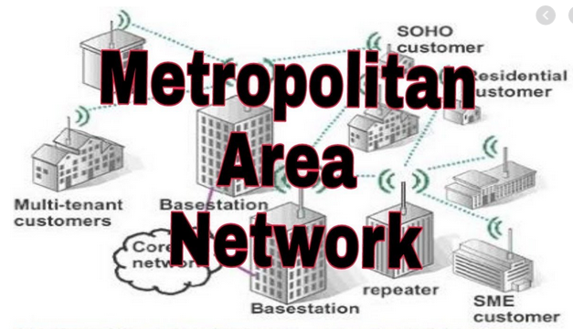
Metropolitan Area Network

Slide 12
Wide Area Network
WAN provides long-distance transmission of data, voice, image and information over large geographical areas that may comprise a country, continent or even the whole world.
In contrast to LANs, WANs may utilize public, leased or private communication devices, usually in combinations, and can therefore span an unlimited number of kilometers

Slide 13
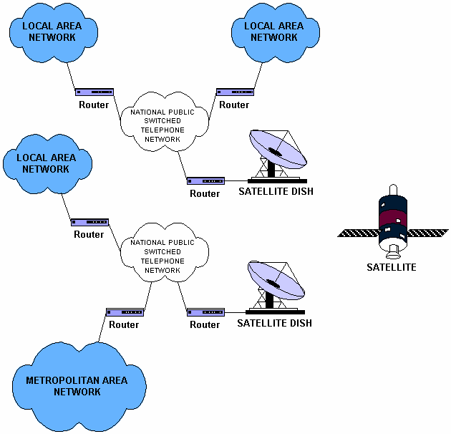
Wide Area Network

Slide 14
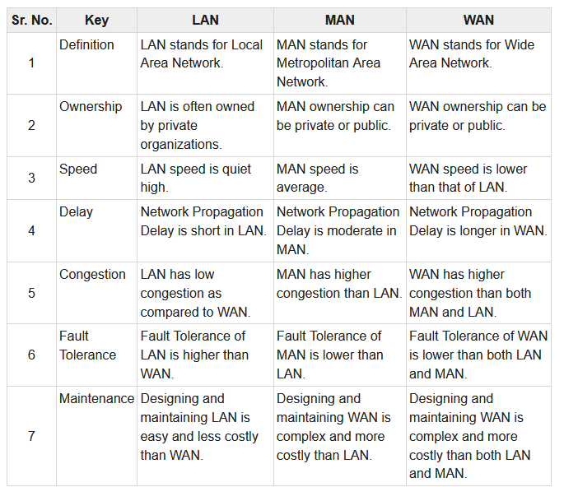
Wide Area Network

Slide 15
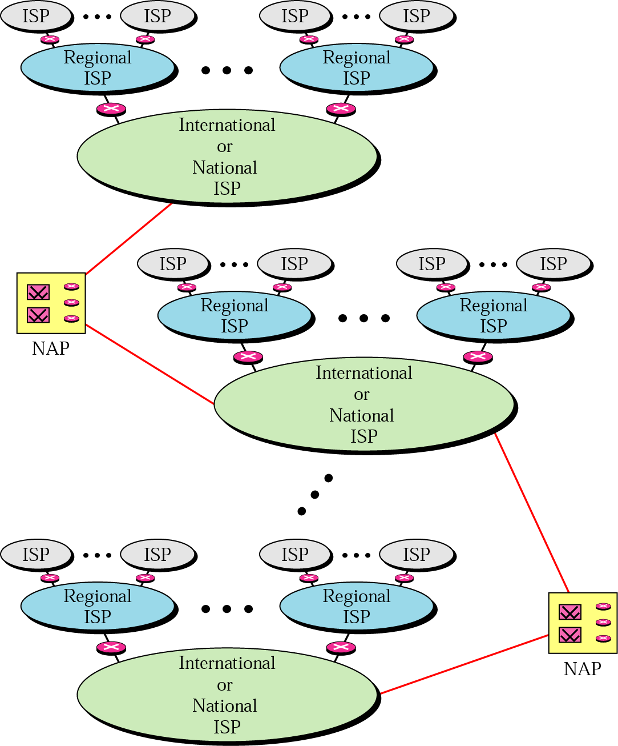
The Internet
Internet is a collection of networks or network of networks.
Various networks such as LAN and WAN connected through suitable hardware and software to work in a seamless manner.

Slide 16
Review Questions
Q-1. What are the two broad classifications under which Networks can be divided?
Q-2. Mention different categories of computer networks (on the basis of scale) and distinguish one from the other.
Q3 Write a note on
  LAN
  WAN
  MAN

Slide 17
Multiple Choice Questions
A _______ is a data communication system within a building, plant, or campus, or between nearby buildings.
a. MAN
b. LAN
c. WAN
d. none of the above
A ______ is a data communication system spanning states, countries, or the whole world.
a. MAN
b. LAN
c. WAN
d. none of the above

Slide 18
Multiple Choice Questions
A _______ is a data communication system within a building, plant, or campus, or between nearby buildings.
a. MAN
b. LAN
c. WAN
d. none of the above
A ______ is a data communication system spanning states, countries, or the whole world.
a. MAN
b. LAN
c. WAN
d. none of the above

Slide 19
Multiple Choice Questions
A _______ is a data communication system within a building, plant, or campus, or between nearby buildings.
a. MAN
b. LAN
c. WAN
d. none of the above
A ______ is a data communication system spanning states, countries, or the whole world.
a. MAN
b. LAN
c. WAN
d. none of the above

Slide 20
Multiple Choice Questions
________ is a collection of many separate networks.
a. A WAN
b. internet
c. a LAN
d. None of the above
There are ______________ Internet service providers.
a. local
b. regional
c. national and international
d. all of the above
A ________ is a set of rules that governs data communication.
a. forum
b. protocol
c. standard
d. none of the above

Slide 21
Multiple Choice Questions
________ is a collection of many separate networks.
a. A WAN
b. internet
c. a LAN
d. None of the above
There are ______________ Internet service providers.
a. local
b. regional
c. national and international
d. all of the above
A ________ is a set of rules that governs data communication.
a. forum
b. protocol
c. standard
d. none of the above

Slide 22


See you in next class

